Slide 1
PORTFOLIO PROJECT · DATA ANALYTICS
From prediction to prescription
A stroke risk analytics pipeline
Most stroke models tell you who is at risk. This one asks the harder question — for each patient, which intervention lowers their risk most, and by how much?
Joseph Kennedy
Descriptive · Predictive · Prescriptive

Slide 2
00 · CONTEXT
The problem
Prediction alone doesn't prevent strokes — action does.
Stroke is the second-leading cause of death worldwide and the leading cause of adult disability. An estimated 80% of strokes are preventable through blood pressure control, glucose management, weight and smoking changes.
80%
Yet most published stroke risk models stop at a probability score — a number, not a plan. For a clinician or a patient, that's the least useful part of the answer.
of strokes are preventable
Source: World Stroke Organization / Lancet Neurology INTERSTROKE study
From Prediction to Prescription · Stroke Risk Analytics Pipeline
02 / 16

Slide 3
00 · DATASET
The dataset at a glance
Kaggle Healthcare Stroke Dataset · a real-world class-imbalance problem.
5,110
12
4.9%
0
patients
features
positive class rate
duplicate rows
Features captured
Cleaning
Demographics: age, gender, ever married, work type, residence type
Clinical: hypertension, heart disease, average glucose, BMI
Behavioural: smoking status
Target: stroke (binary)
201 missing BMI values imputed by (age × gender) group mean, with a gender-only fallback for empty buckets.
One 'Other' gender row dropped for modelling — n=1 not learnable.
Categorical variables one-hot encoded; binaries mapped 0/1; features standardised for linear and NB models.
From Prediction to Prescription · Stroke Risk Analytics Pipeline
03 / 16

Slide 4
00 · APPROACH
A three-layer analytics stack
Descriptive → Predictive → Prescriptive · each layer answers a different question.
01
02
03
DESCRIPTIVE
PREDICTIVE
PRESCRIPTIVE
Who does this happen to?
Who is likely to be next?
What should we do about it?
Profile the sample and the stroke cohort. Distributions, comorbidities, age and glucose skews. Build the intuition a model has to respect.
Four base models and three ensembles benchmarked head-to-head under class imbalance. Full diagnostic pack: ROC, PR, calibration, SHAP.
Calibrate probabilities so they mean what they say, then run per-patient counterfactuals: how much does risk drop if hypertension, glucose, BMI or smoking is addressed?
EDA & data cleaning
Logistic · XGBoost · RF · NB · Stacking
Calibrated risk % + counterfactual advice
From Prediction to Prescription · Stroke Risk Analytics Pipeline
04 / 16

Slide 5
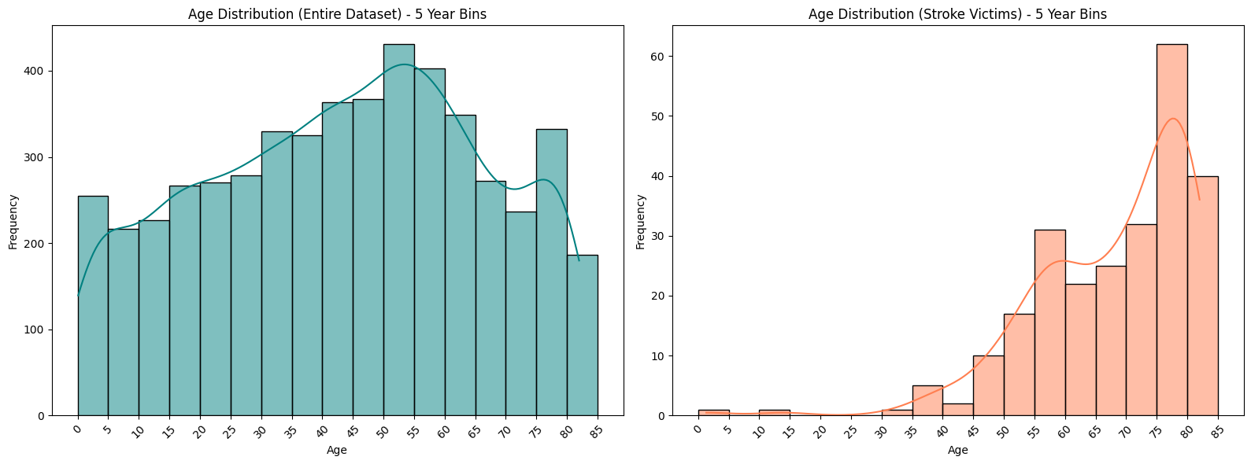
01 · DESCRIPTIVE
Age dominates the signal
Stroke incidence rises sharply from age 55 and concentrates 65+.
Key take-aways
Whole-population age distribution is roughly uniform 0–80.
Stroke cohort skews heavily into the 60–80 bracket.
One outlier: a 1.32-year-old case — real-world data isn't clean.
Age becomes the single strongest predictor in every model that follows.
From Prediction to Prescription · Stroke Risk Analytics Pipeline
05 / 16

Slide 6
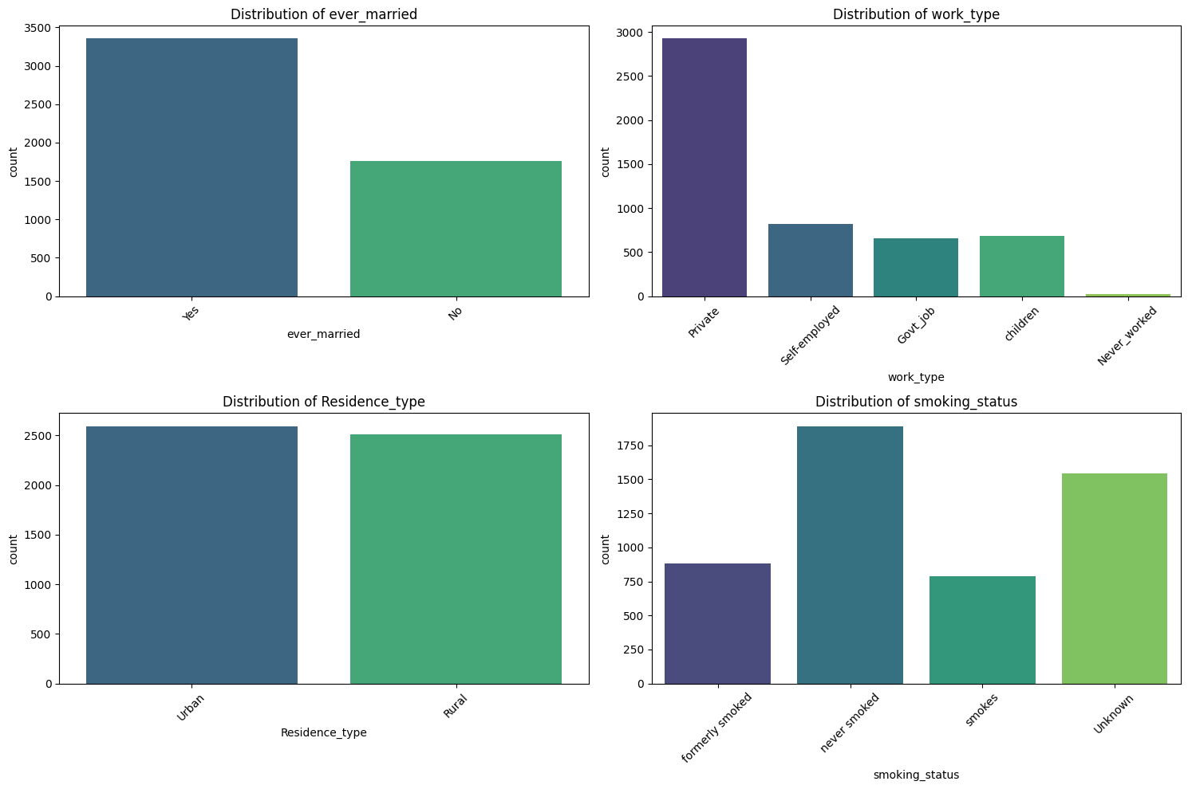
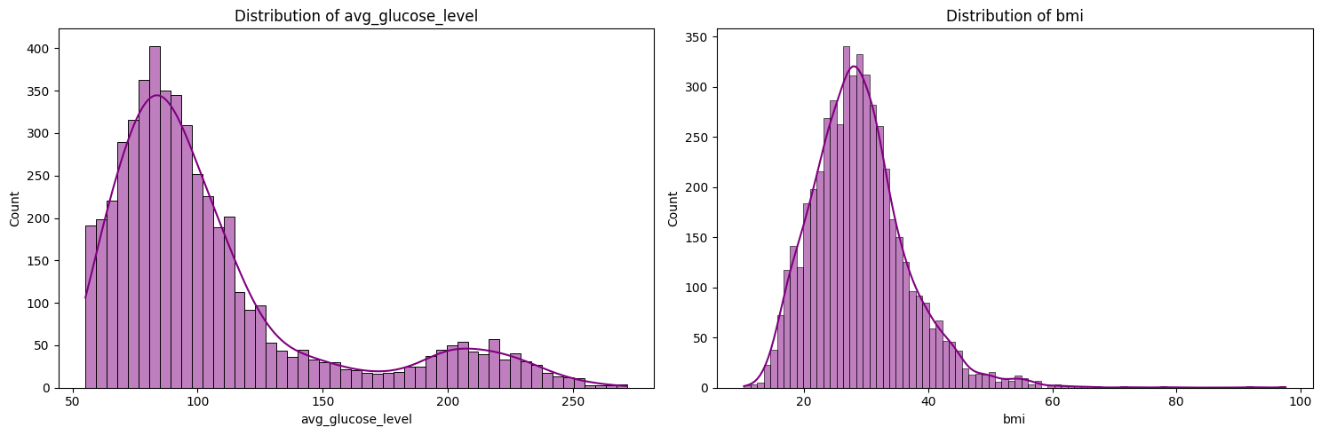
01 · DESCRIPTIVE
Feature distributions across the sample
Where the population sits on the modifiable risk factors.
From Prediction to Prescription · Stroke Risk Analytics Pipeline
06 / 16

Slide 7
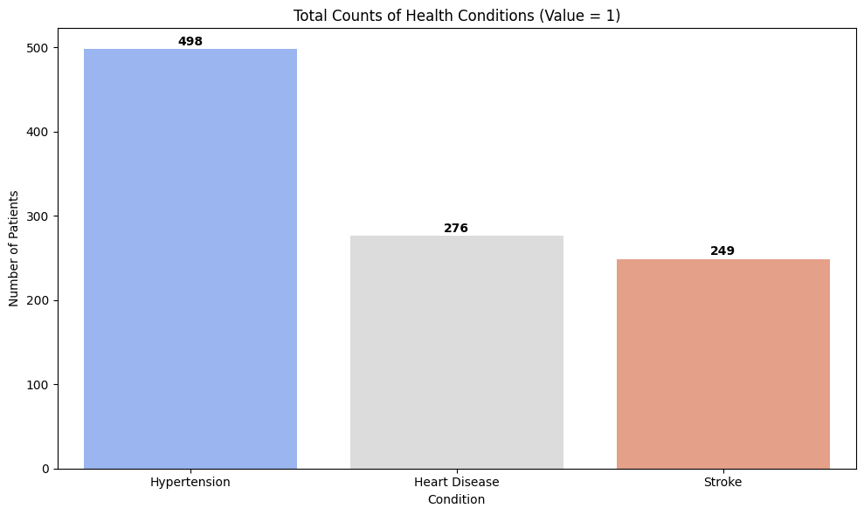
01 · DESCRIPTIVE
Comorbidity totals in the sample
Hypertension and heart disease sit far above the stroke base rate.
Why this matters
Stroke is a low base-rate event — ~5% of the sample.
Comorbidities are ~10× more common than the outcome.
Modelling has to handle class imbalance without letting the majority class dominate.
Approach: class_weight='balanced' for linear / RF / NB, and scale_pos_weight for XGBoost.
From Prediction to Prescription · Stroke Risk Analytics Pipeline
07 / 16

Slide 8
02 · PREDICTIVE
Four models, three ensembles
Each model brings a different worldview — combined they cover the space.
Interpretable
Non-linear
Ensemble native
Logistic Regression
XGBoost
Random Forest
Interpretable baseline. Standardised coefficients read like factor loadings — direct effect on log-odds of stroke.
Gradient-boosted trees. Handles non-linearities and interactions; SHAP values expose exactly what it learned.
500 trees voting. Feature importance with std bars, plus partial-dependence plots that reveal each feature's functional form.
Probabilistic
Ensembles
Meta-learner
Naive Bayes
Voting (equal & AUC-weighted)
Stacking
Fast probabilistic baseline. Its Gaussian assumption is exposed by overlaying assumed vs. actual distributions.
Soft-vote averages of the four base models — equal weights vs. weighted by individual AUC.
Meta-logistic regression trained on cross-validated base-model predictions — learns which model to trust when.
From Prediction to Prescription · Stroke Risk Analytics Pipeline
08 / 16

Slide 9
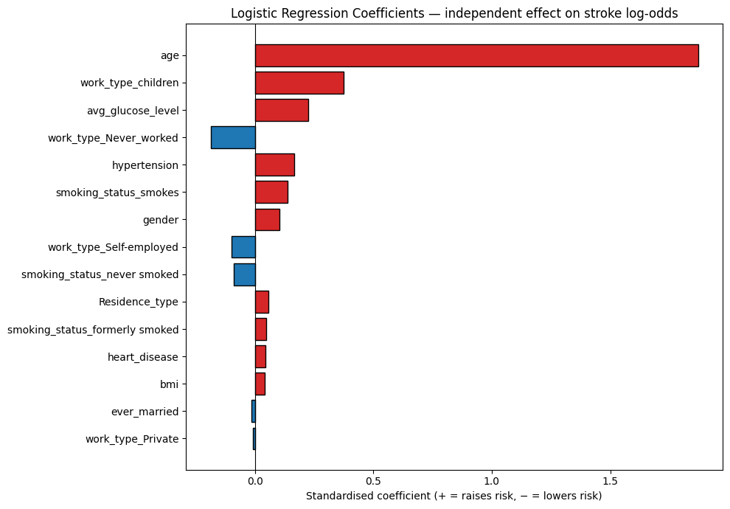
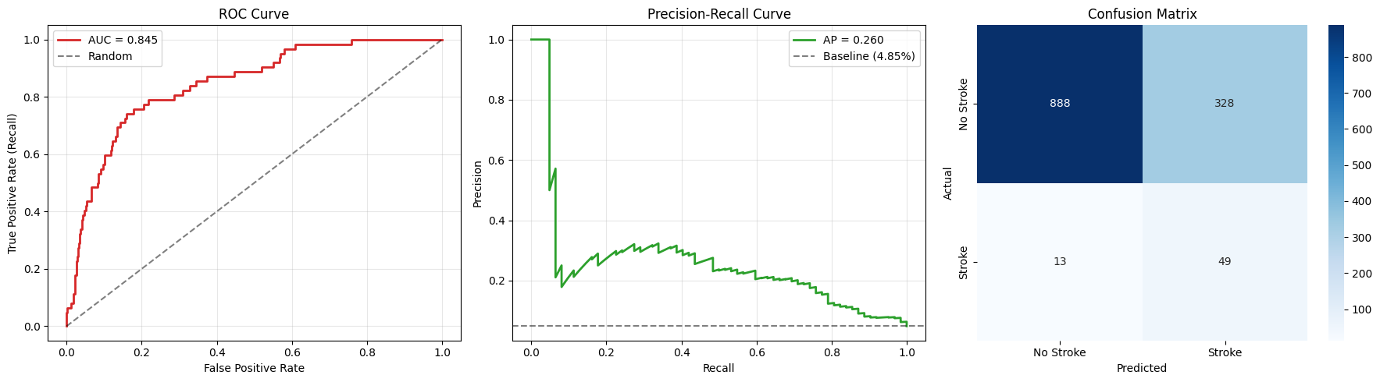
02 · PREDICTIVE
Logistic regression — the interpretable baseline
Coefficients read like standardised factor loadings — direct effect on the log-odds of stroke.
From Prediction to Prescription · Stroke Risk Analytics Pipeline
09 / 16

Slide 10

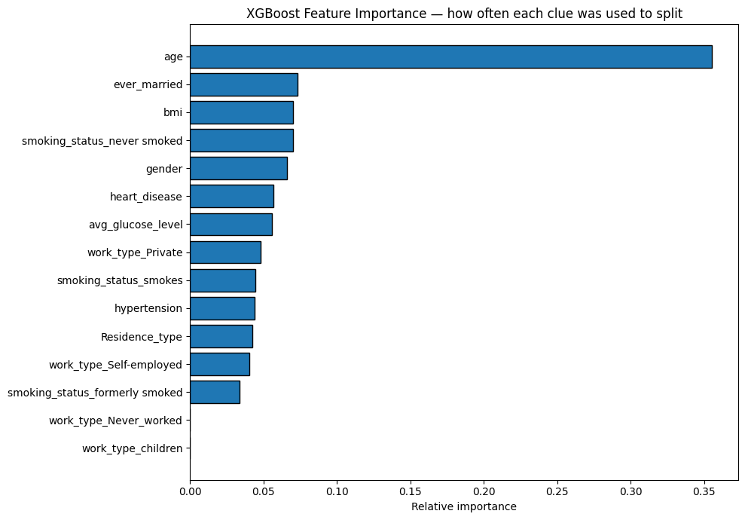
02 · PREDICTIVE
XGBoost — capturing non-linearities
SHAP values expose which features drove each individual prediction.
From Prediction to Prescription · Stroke Risk Analytics Pipeline
10 / 16

Slide 11
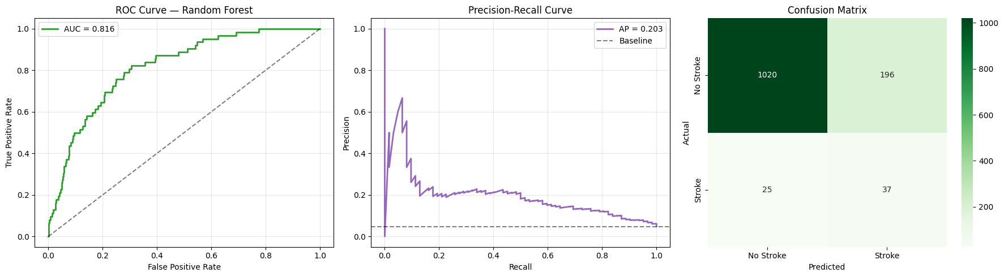
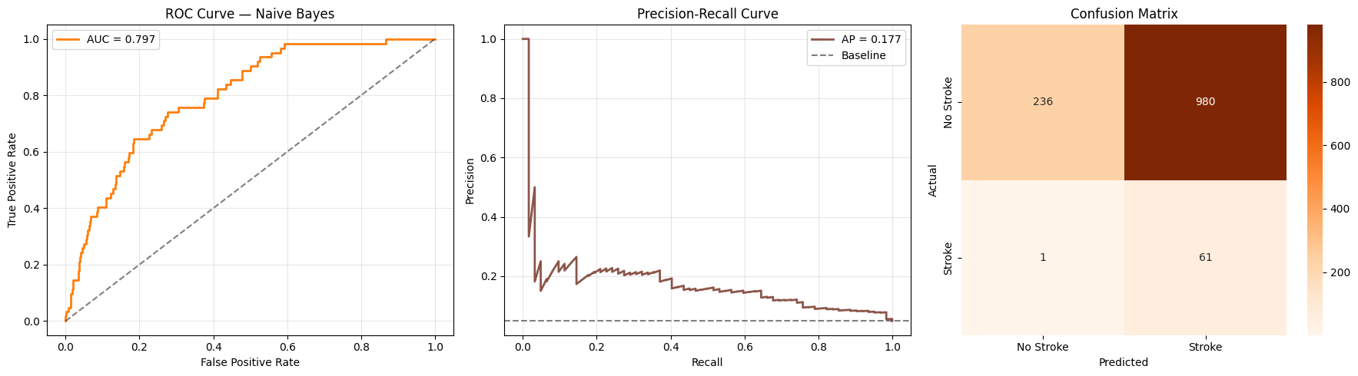
02 · PREDICTIVE
Random Forest & Naive Bayes
One bagged-tree learner and one probabilistic baseline — for coverage of the model space.
From Prediction to Prescription · Stroke Risk Analytics Pipeline
11 / 16

Slide 12
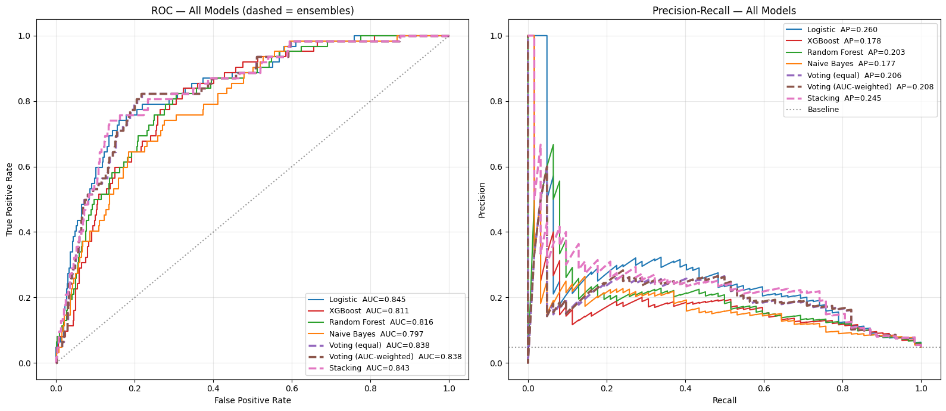
02 · PREDICTIVE
The leaderboard — ensembles vs. base models
ROC-AUC, PR-AUC and calibration compared head-to-head.
Reading the chart
AUC alone is a misleading metric under 5% base rate — PR-AUC and calibration matter as much.
The stacking ensemble edges base models on ranking, but gains are marginal.
Naive Bayes' probabilities are systematically over-confident — visible in the calibration curve.
Chosen for prescriptive layer: calibrated logistic regression — simple, honest, best calibration.
From Prediction to Prescription · Stroke Risk Analytics Pipeline
12 / 16

Slide 13
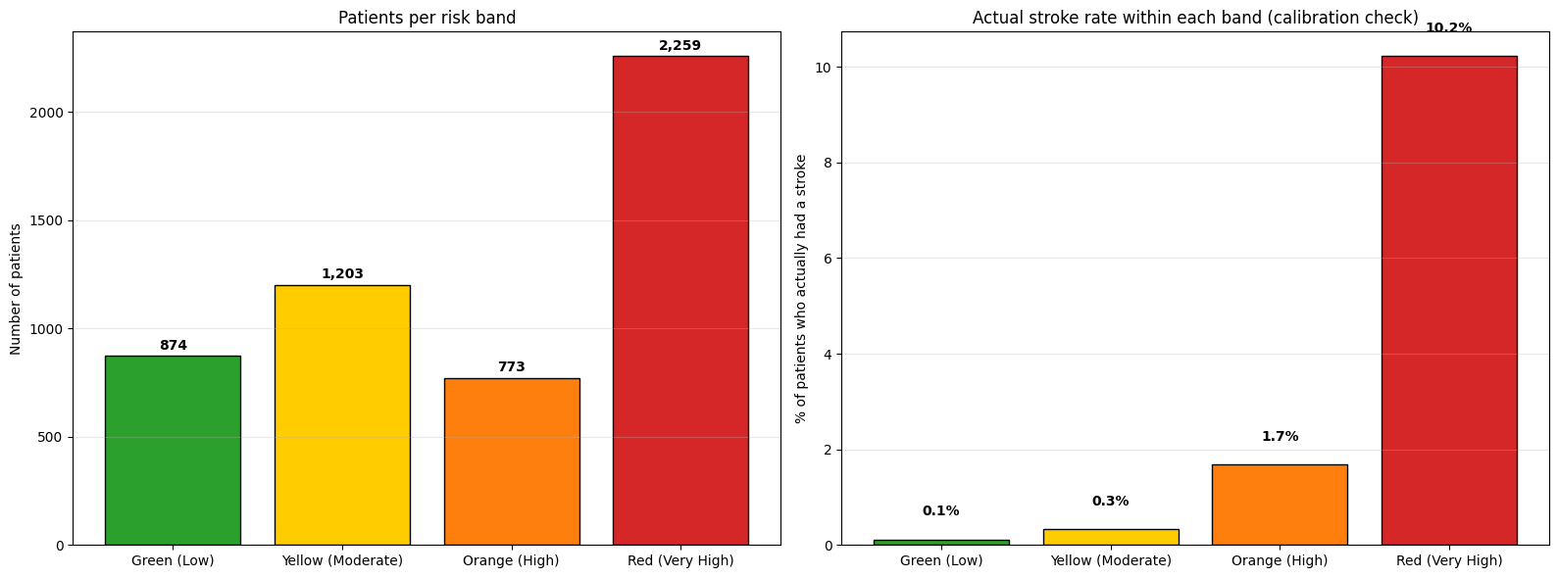
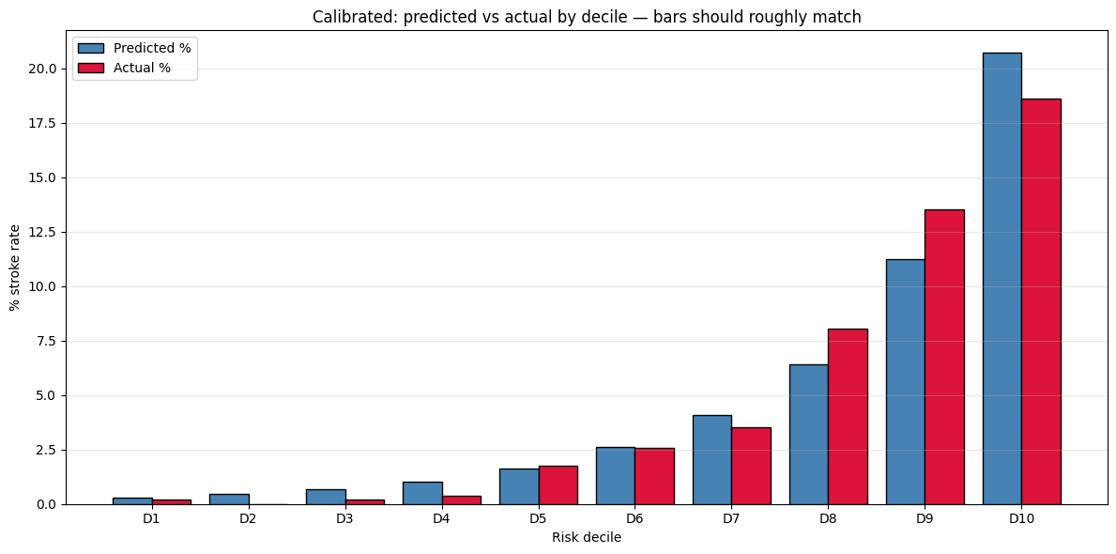
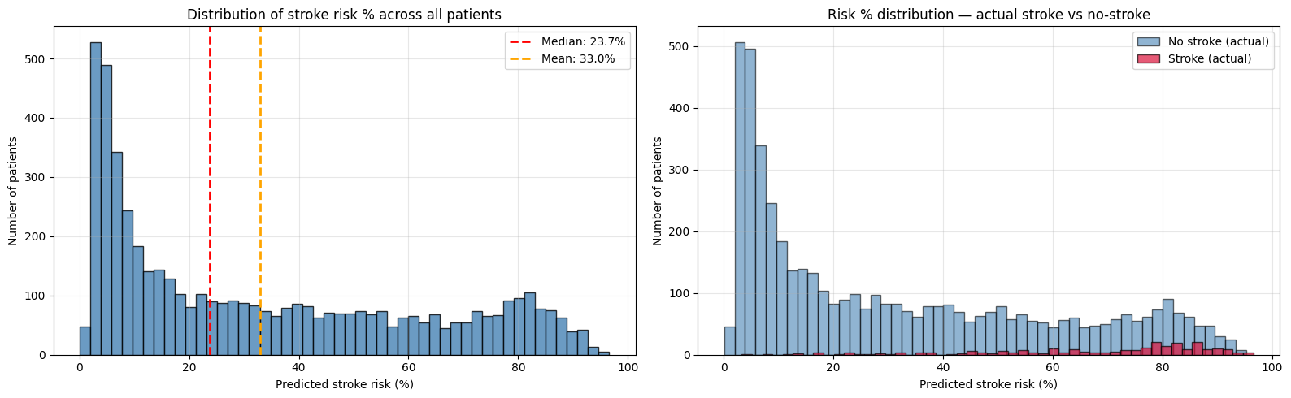
03 · PRESCRIPTIVE
Calibrated risk % — bands that mean what they say
Platt scaling via 5-fold CV corrects class-weighted probabilities back to reality.
From Prediction to Prescription · Stroke Risk Analytics Pipeline
13 / 16

Slide 14
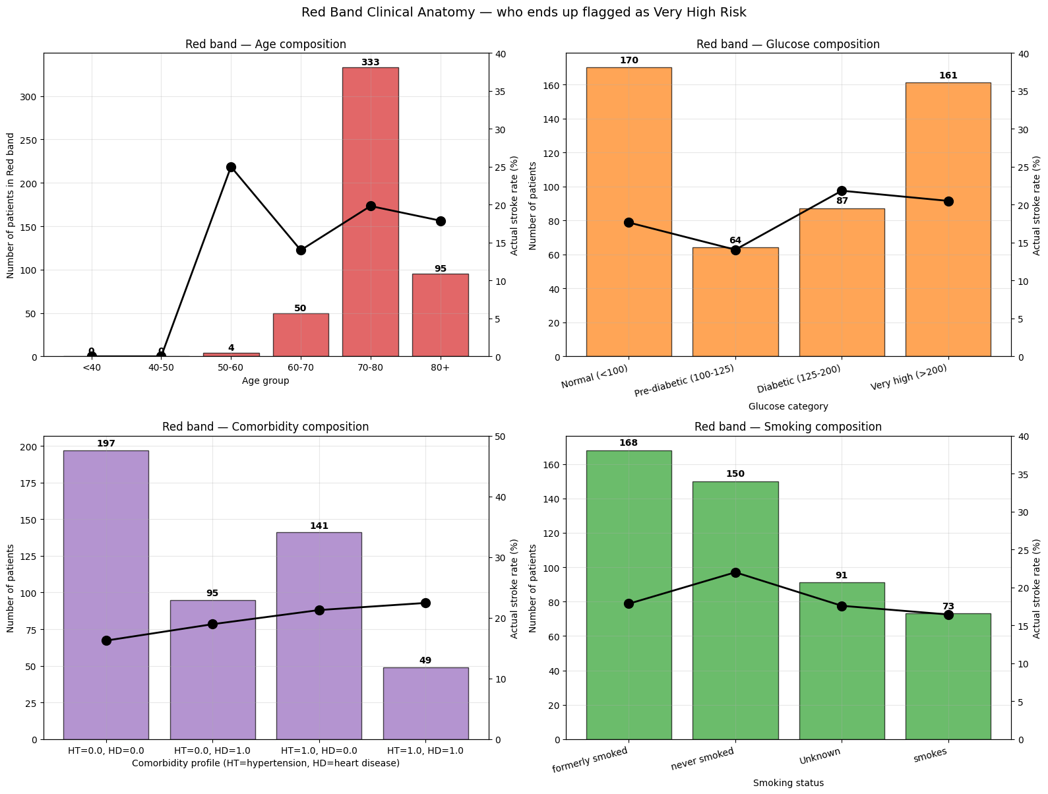
03 · PRESCRIPTIVE
Anatomy of the Red band
Who ends up flagged Very High Risk — and are those flags clinically credible?
Clinical sanity check
Red band concentrates the expected profile: older, hypertensive, elevated glucose.
Actual stroke rate rises monotonically with model-predicted band.
Counterfactual layer isolates the modifiable slice of risk — what a clinician can actually change.
Each patient gets a natural-language advice string with ranked interventions.
From Prediction to Prescription · Stroke Risk Analytics Pipeline
14 / 16

Slide 15
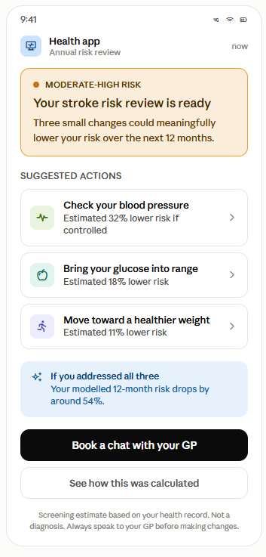
03 · SOLUTION
The solution — a patient-facing risk alert
Where the analytics lands: an app alert built on the calibrated risk model and counterfactual advice.
Design principles
Language over numbers
A raw 22% figure without context creates anxiety, not action. The band and framing lead — the model's math sits behind a 'See how this was calculated' tap.
Actions ranked by modelled impact
Each intervention shows the estimated relative risk reduction — direct from the counterfactual layer in the notebook.
Route the patient to a clinician
Primary CTA is 'Book a chat with your GP'. Never a self-diagnosis loop.
Honest disclaimer
'Screening estimate. Not a diagnosis.' — the line that keeps the tool on the right side of MHRA / CE-marking rules.
From Prediction to Prescription · Stroke Risk Analytics Pipeline
15 / 16

Slide 16
PORTFOLIO PROJECT · CLOSING
Limitations & tools used
Limitations
Tools used
Screening tool, not a diagnostic. With a ~5% base rate, high recall costs precision at every threshold.
Observational data. Counterfactuals are model-implied risk reductions, not causal estimates.
Feature set is limited — no BP number, cholesterol, medication history or imaging.
Single dataset, no external validation. A production model needs a held-out cohort from a different source.
Age dominates. Much of the 'high risk' flag is really 'old' — the counterfactual layer isolates what's actually modifiable.
Language & environment
Python 3 · Jupyter / Google Colab
Data
pandas · numpy
Modelling
scikit-learn · xgboost · shap · CalibratedClassifierCV
Visualisation
matplotlib · seaborn
Export & delivery
xlsxwriter · README + this deck
Joseph Kennedy · Data Analytics Portfolio

